Slide 1
SAP-3
Md. Aashikur Rahman Azim
Lecturer
CSE, BUET

Slide 2
Introduction
SAP-3 is an 8-bit microcomputer that is upward compatible with 8085.
SAP3 includes all SAP2 features.
It includes stack operations.

Slide 3
SAP2 - Architecture
Bus W
Ack
Encoder
Hexa
8
A
8
8
In Port 1
8
8
ALU
2
Flag
8
Ready
0
8
8
7
In Port 2
TEMP
Serial In
PC
16
8
B
MAR
16
8
C
16
Memory
8
MDR
8
Out Port 3
Hexa Disp
8
8
IR
8
Out Port 4
0
Serial Out
8
7
Ack
8
CON

Slide 4
Architecture (Like as SAP2)
PC
A
SP
B
C
D
E
F
H
L

Slide 5
Program Counter
16 bit address
Thus can count from
PC= 0000 0000 0000 0000
PC= 1111 1111 1111 1111(FFFFH)

Slide 6
Memory Data Register
8-bit Register
Output setup RAM
Receives data from the bus before write operation
Data to the bus after read operation

Slide 7
Instruction Register
8-bit op code
Can accommodate 256 instruction
Around 246 instructions

Slide 8
Controller Sequencer
As usual → Like SAP2

Slide 9
Accumulator
Same as SAP-1

Slide 10
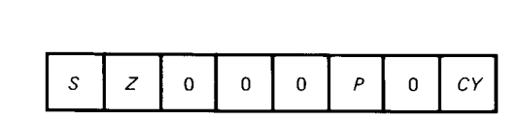
ALU and Flags
ALU: Includes both arithmetic and logical operation
4 or more control bits for determining the operation to be performed
Flag: Represent the status of the arithmetic and logical operation
8-bit Register Used;
Zero Flag(Z)
Sign Flag(S)
Carry Flag(CY)
Parity Flag (P)

Slide 11
Temp
Temporary register (TEMP) → like SAP2

Slide 12
Microprocessor Instructions

Slide 13
MOV & MVI
MOV reg1, reg2
reg1 = A, B, C, D, E, H, L
reg2 = A, B, C, D, E, H, L
MVI reg, byte
reg = A, B, C, D, E, H, L

Slide 14
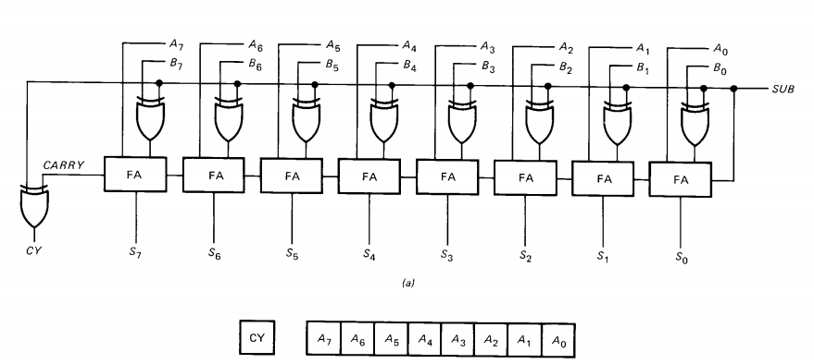
Carry Flag (CY)

Slide 15
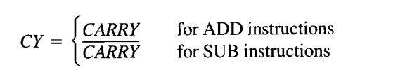
Carry Flag (CY) Contd.
Add → Carry
Sub → Borrow

Slide 16

Carry Flag Instructions
STC → SeT Carry (CY =1)
CMC → CompleMent Carry
CY = $\overline{CY}$

Slide 17
ADD
ADD reg
reg = A, B, C, D, E, H, L

Slide 18
ADC
ADC → ADD with Carry (CY).
SUB reg
reg = A, B, C, D, E, H, L
Example: A = 1111 1111 E = 0000 0000 CY =1.
SBB E ➔ 1111 1111
+ 0000 0001
-----------------------------------------------
10000 0000
→ At the End, CY = 1. A = 0000 0000

Slide 19
SUB
SUB reg
reg = A, B, C, D, E, H, L

Slide 20
SBB
SBB → Subtract with borrow (CY).
SUB reg
reg = A, B, C, D, E, H, L
Example: A = 1111 1111 E = 0000 0010 CY =1.
SBB E ➔ 1111 1111
- 0000 0011
-----------------------------------------------
1111 1100

Slide 21
Increment
INC reg
reg = A, B, C, D, E, H, L
INC has no effect on the carry.

Slide 22
Decrement
DEC reg
reg = A, B, C, D, E, H, L
DEC has no effect on the carry.

Slide 23
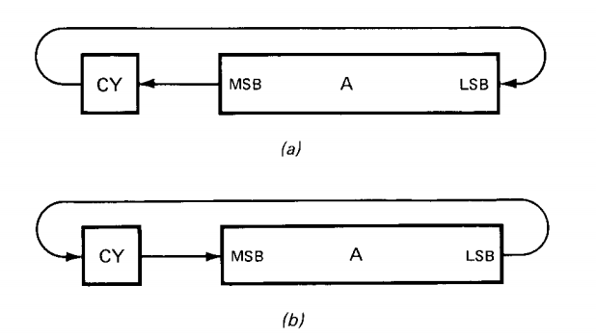
RAL & RAR
RAL → Rotate All Left (a)
RAR → Rotate All Right (b)

Slide 24
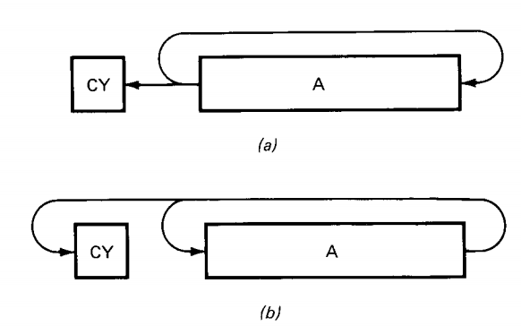
RLC & RRC
RLC → Rotate Left with Carry (a)
RRC → Rotate Right with Carry (b)
Multiplication & Division

Slide 25
Logic Instructions
ANA reg
ORA reg
XRA reg
reg = A, B, C, D, E, H, L

Slide 26
Compare Instruction
CMP reg
reg = A, B, C, D, E, H, L
Z flag effected after the operation

Slide 27
Arithmetic & Logic Immediate
ANI byte
ORI byte
XRI byte
ADI byte → ADD immediate
ACI byte → ADD with carry immediate
SUI byte → SUB immediate
SBI byte → SUB with borrow immediate
CPI byte → Compare Immediate

Slide 28
Parity Flag (P)
P = 1, if A has EVEN number of ‘1’
P = 0, otherwise

Slide 29
Jump And Call Instruction
SAP2
JMP address
JM (Jump if Minus)
JZ(Jump if zero)
JNZ(Jump if not zero)
SAP3
JP (Jump if positive)
JC ( Jump id Carry)
JNC ( Jump if not Carry)
JPE (Jump if Even Parity)
JPO (Jump if Odd Parity)

Slide 30
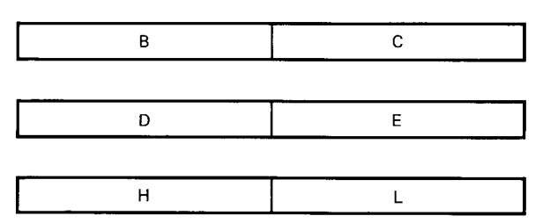
Extended Register
Register pairs → 16 bits
3 pairs (BC, DE and HL)

Slide 31
Extended Instructions
X → for Extended instruction
LXI B, dble
LXI D, dble
LXI H, dble
Example: LXI B, 90FFH
B = 90H, C = FFH

Slide 32
Extended Instructions
DAD instruction → Double ADD
DAD B
DAD D
DAD H
Here, default register Pair is HL, works like A for extended ADD.

Slide 33
Extended Instructions
INX & DCX instruction
INX B, INX D, INX H
DCX B, DCX D, DCX H
No Flags will be effected after these operations.

Slide 34
Indirect Instructions
The HL register pair points to the memory locations where data is stored, means HL is a data pointer.
LDA address and STA address
HL = address
Use HL pair to access memory location

Slide 35
Indirect Read
MOV reg, M
reg = A, B, C, D, E, H, L
M = memory address
HL ← M

Slide 36
Indirect Write
MOV M, reg
reg = A, B, C, D, E, H, L
M = memory address
HL ← M

Slide 37
Indirect Immediate Instructions
MVI M, byte
M = memory address
HL ← M

Slide 38
Other Instructions by HL pointer
ADD M
ADC M
SUB M
SBB M
INC M
DEC M
ANA M
ORA M
XRA M
CMP M

Slide 39
STACK Instructions
Begin Address: 20FFh
End Address: 20E0h
PUSH, POP
Before call we need to store registers & Flags
PUSH B (BC)
PUSH D (DC)
PUSH H (HL)
PUSH PSW

Slide 40
PUSH operation
When PUSH instruction is executed, the following things happen:
The SP is decremented to get a new value of SP-1
The high byte in the specified register pair is stored in M[SP-1]
The SP is decremented again to get SP-2
The low byte in the specified register pair is stored in M[SP-2]

Slide 41
POP Operation
When POP is executed, the following happens:
REVESE of PUSH !!

Slide 42
Call & RET Instructions
CALL
Subroutine ????
Call is used to call the subroutine
Ret
Return back from subroutine
Program Counter contents and other values (FLAGS) ????
-----stored in the STACK

Slide 43
Conditional CALLs
CNZ address
CZ address
CNC address
CC address
CPO address
CPE address
CP address
CM address

Slide 44
Conditional RETURNs
RNZ
RZ
RNC
RC
RPO
RPE
RP
RM

Slide 45
Thank you

